Slide 1
Azure DevOps case
Take home assignment

Slide 2
Azure DevOps case
Introduction
Requirements
In this assignment you will take use of Infrastructure As Code, a concept that is an important part of cloud development.
The technology for deploying infrastructure will be Azure Resource Manager or ARM templates.
Since we most often want to reuse already existing ARM-templates within our organization, where the naming conventions is implemented, you will be provided with a couple of templates for creating an Application Insights, App Service Plan and App Service.
Your task is to complete the master template (sof-exchangerate.json) and the parameter file (sof-exchangerate-dit-parameters.json) to create a hosting environment for your exchange rate api using the preprepared organization templates.
Starting solution is avalible to fork here: https://github.com/CrayonGroup/Azure-DevOps-Take-home-assignment
Put your source code in a repository, and send us the information we need to access it. We suggest you use a public repo on github.
We also expect to run your code via the command line provided in the powershell script New-ScaleUnitDeployment.ps1.
We expect your deployment solution to be fully functional setting up the components for the scale unit, but you should time-box this assignment to a maximum of 3 hours.
Your solution should use Azure Resource Manager templates and reuse existing templates already created by the organization.
Good luck, and happy coding!

Slide 3
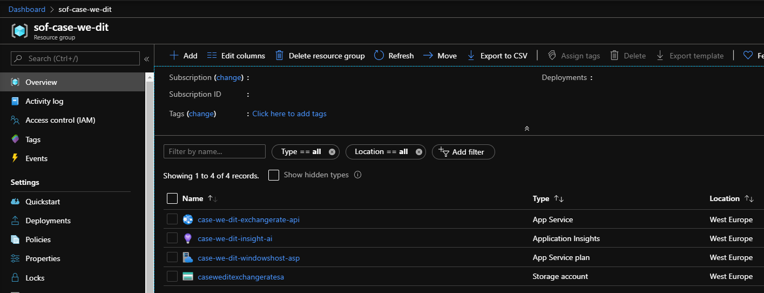
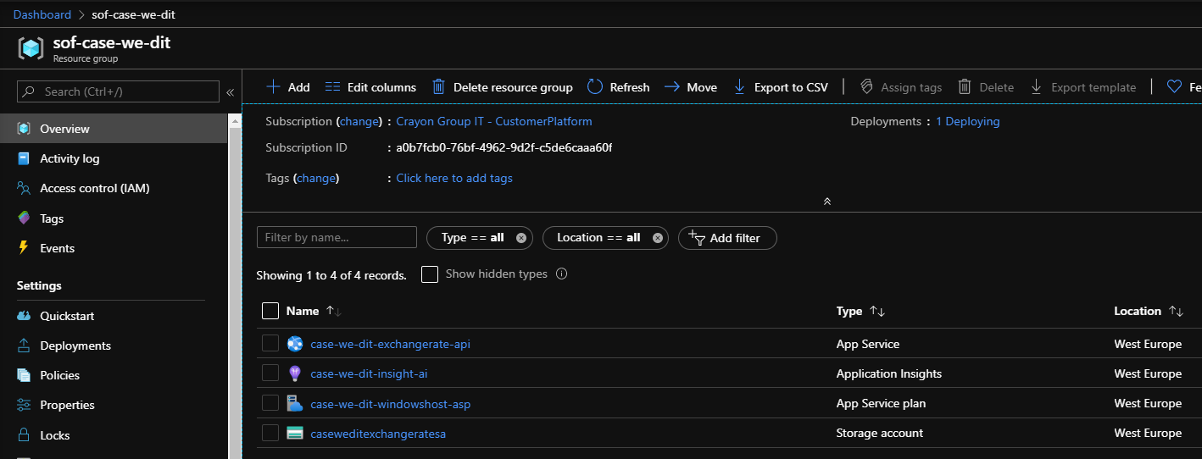
End result

